Slide 1
Myntra application
Way to enjoy from home!!!

Slide 2
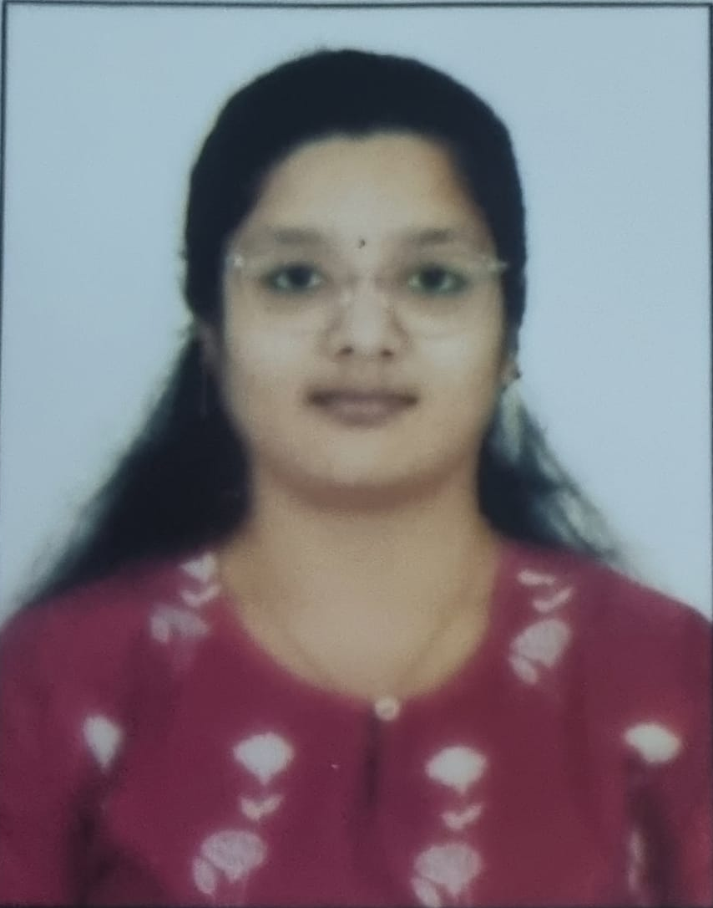
NAME: A. GAYATRI ROLL NO: CB.SC.I5DAS21010 Github: Gayatri-0507 (github.com)

Slide 3
ABOUT THE APPLICATION
This application is to make online shopping easier. Availability of wide range of products like accessories, clothes, shoes etc. The searching process is easier with categories. The products suggested are based on the previous search or previous orders. Here comes the major role of data it should show only the customer’s choice what would the like to buy or what will be better for them. The number of items present of a choice. Discounts available on a particular product or discount on usage of any bank card are all present to make shopping easy with door step service in all brands present across the world.

Slide 4
REPORT
Report Name | Purpose
Daily Sales Report | To track daily sales and revenue
User Activity Report | Analyzing user engagement and interaction
Inventory Status | Monitoring stock levels and product availability
Conversion Rate | Calculating the rate of conversion from visits to purchases
Customer Retention | Tracking returning customers and retention rates
Marketing Campaign | Evaluating the effectiveness of marketing campaigns
Trend Analysis | Identifying popular products and shopping trends

Slide 5
Two Content Layout with Table
First bullet point here
Second bullet point here
Third bullet point here
Class | Group 1 | Group 2
Class 1 | 82 | 95
Class 2 | 76 | 88
Class 3 | 84 | 90

Slide 6
TECHNOLOGIES
Front End | Editor: Visual Studio (versatile integrated development environment (IDE) used for front-end Language: HTML, CSS used for front-end development. Framework: HTML, CSS
Back End | Editor: Visual Studio Language: JavaScript Framework: Node.js

Slide 7
REQUIREMENT
Myntra is an indispensable application due to its convenience, offering a vast array of fashion products from numerous brands, personalized recommendations, intuitive user interface, exclusive deals, reliable delivery, and hassle-free returns. It's a one-stop destination that caters to diverse fashion needs, providing users with trends, reviews, and a seamless shopping experience from the comfort of their homes.

Slide 8
SIMILAR APPLICATIONS
Application Name | URL
Ajio | Online Shopping for Women, Men, Kids – Clothing, Footwear | AJIO
Limeroad | Online Shopping Site - Shop Men & Women Fashion Online in India (limeroad.com)
Amazon Fashion | Amazon Fashion: Clothing, Footwear and Accessories online for Men, Women and Kids
Snapdeal | Shop Online for Men, Women & Kids Clothing, Shoes, Home Decor Items (snapdeal.com)

Slide 9
TABLE THAT CAN BE USED
Table Name | Purpose
User | Manages user accounts and facilitates login
Customer Details | Stores information of all customers who have shopped
Category Details | Serves as a master table for various product categories
Payment Methods | Serves as a master table for various payment methods
Brands | Serves as a master table for different product brands
Promotion | Stores promotional campaign details
Order Details | Records transactions and details of customer orders
Refund Transaction | Records transactions related to refunds
Reviews | Stores customer reviews and ratings
Cart | Manages items added to the shopping cart
Address | Stores shipping and billing addresses
Product | Contains details about various products available

Slide 10
BASIC QUERIES
Create:
Purpose: Create a new database object (table, index, view, etc.).
Syntax:
CREATE TABLE table_name (column1 datatype, column2 datatype, ...);
1.Create
2.insert
3.Delete
4.Update

Slide 11
BASIC QUERIES
Insert:
Purpose: Add new records to a table.
Syntax:
INSERT INTO table_name (column1, column2, ...) VALUES (value1, value2, ...);
1.Create
2.insert
3.Delete
4.Update

Slide 12
BASIC QUERIES
Delete:
Purpose: Remove rows from a table.
Syntax:
DELETE FROM table_name WHERE condition;
1.Create
2.insert
3.Delete
4.Update

Slide 13
BASIC QUERIES
Update:
Purpose: Modify existing records in a table.
Syntax:
UPDATE table_name SET column1 = value1, column2 = value2 WHERE condition;
1.Create
2.insert
3.Delete
4.Update

Slide 14
JOINS
Full Outer Join:
Purpose: Retrieves all records when there is a match in either the left or right table, combining the results of both left and right joins.
Right Join (or Right Outer Join):
Purpose: Retrieves all records from the right table (Table2) and matching records from the left table
Left Join (or Left Outer Join):
Purpose: Retrieves all records from the left table (Table1) and matching records from the right table

Slide 15
NESTED QUERIES
Types:
Single Row Subquery:
Multiple Row Subquery:
Scalar Subquery:
Queries I have used are:
Correlated Subqueries: Queries where the inner subquery references a table from the outer query. For
IN Subqueries: Queries using the IN operator to check if a value exists within a subquery's result
Scalar Subqueries: Subqueries that return a single value.
Subqueries in WHERE clause: Queries where the subquery is employed in the WHERE clause to filter results.
Nested queries, also known as subqueries, are SQL queries embedded within another query. They allow for more complex and specific data retrieval or manipulation by leveraging the results of one query as a condition or dataset for another query within the same SQL statement.

Slide 16
VIEW
Purpose: Views act as saved SQL queries representing virtual tables.
Creation: Generated using CREATE VIEW with a SELECT statement.
Usage: Accessed like tables for querying but don't store data.
Benefits:
Abstraction: Simplify complex queries and data structures.
Security: Control user access to specific data.
Convenience: Offer a way to present data in a structured format.
Limitations: Updates may be restricted for certain views, especially those involving complex operations or joins.
1. **PaymentMethods_View**:
- **Purpose**: Filters `paymentmethods` table for IDs 1 to 5.
- **Usage**: Displays a subset of payment methods.
2. **Male_Customers_View**:
- **Purpose**: Shows only male customers from the `customers` table.
- **Usage**: Provides a view focused on male customer data.Convenience: Offer a way to present data in a structured format.

Slide 17
PLSQL
Purpose: Extends SQL functionality by incorporating procedural elements like loops, conditions, and exception handling.
Usage: Enables writing procedural logic within Oracle databases for complex data operations and business logic.
Features: Includes variables, loops (FOR, WHILE), conditional statements (IF-THEN-ELSE), exception handling (TRY-CATCH), procedures, functions, triggers, and packages.
GetPaymentMethodDescription: to fetch payment method descriptions by ID and tests it.
Count_Male_Customers:creates a procedure to count male customers and displays the count.

Slide 18
CURSOR
Purpose: Facilitates row-by-row processing of query results.
Types:
Implicit Cursors: Automatically created for single-row queries without explicit declaration.
Explicit Cursors: User-defined and offer more control over query result handling.
Usage: Iterates through query results, allowing manipulation of individual rows fetched from the database.
Lifecycle:
Declare: Define cursor structure and associate it with a query.
Open: Execute the query and make the result set available for processing.
Fetch: Retrieve rows sequentially from the result set.
Close: Release cursor resources after processing.
C1: to fetch and display customer IDs, names, and addresses from the 'customers' table.
c_addresses: retrieves address IDs and customer IDs from the 'addresses' table where the state is 'CA' using a cursor and prints the results.

Slide 19
TRIGGER
Purpose: Triggers are special stored procedures that automatically execute in response to specific events (like INSERT, UPDATE, DELETE) on a table.
Usage: They enforce business rules, maintain data integrity, and automate actions within the database.
Types: They can be categorized as BEFORE, AFTER, or INSTEAD OF triggers based on when they fire concerning the triggering event.
Applications: Used to enforce constraints, log changes, or perform specific actions when data in a table is modified. ets a default description value for the 'categories' table when a new row is inserted if the description field is null.
Set_Default_Category: sets a default description value for the 'categories' table when a new row is inserted if the description field is null.
Check_Refund_Date: applied to the 'products' table, ensures that the 'Refund_date' field is not in the past when inserting or updating records. If a refund date in the past is encountered, it raises an application error (-20001) to prevent the operation.

Slide 20
WEB APPLICATION
Form Name | Category(Master /Transaction) | Table Name associated with the form | Form Name /css For ex: Emp_master.html Emp,m_master.css | File Name for reference in the shared drive | Type of operations (Insert/Update/Delete /Search/Display)
Customer details form | Master | customer details | customer details.html customer.css | customer details.html customer.css | search
Category details form | Master | category details | Category.html Category.css | Category.html Category.css | display,search
Promotion details form | Master | promotion details | Promotions.html Promotion.css | Promotions.html Promotion.css | display,search
Payment method details form | Master | payment method details | Payment method.html Payment.css | Payment method.html Payment.css | update,display
Brand details form | Master | brand details | Brand details.html Brand.css | Brand details.html Brand.css | display,search
Payment transaction form | Transaction | Payment transaction details | Payment transaction.html Payment transaction.css | Payment transaction.html Payment transaction.css | display,search
Refund transaction form | Transaction | Refund transaction details | Refundtransaction.html Refund.css | Refundtransaction.html Refund.css | update
Address form | Transaction | address details | Address.html Address.css | Address.html Address.css | insert,update
Order details form | Transaction | order details | Order details.html Order.css | Order details.html Order.css | display,search
Cart form | Transaction | cart details | Cart.html Cart.css | Cart.html Cart.css | insert,uodate,delete
Product detail form | Transaction | product details | product details.html product.css | product details.html product.css | display,search

Slide 21
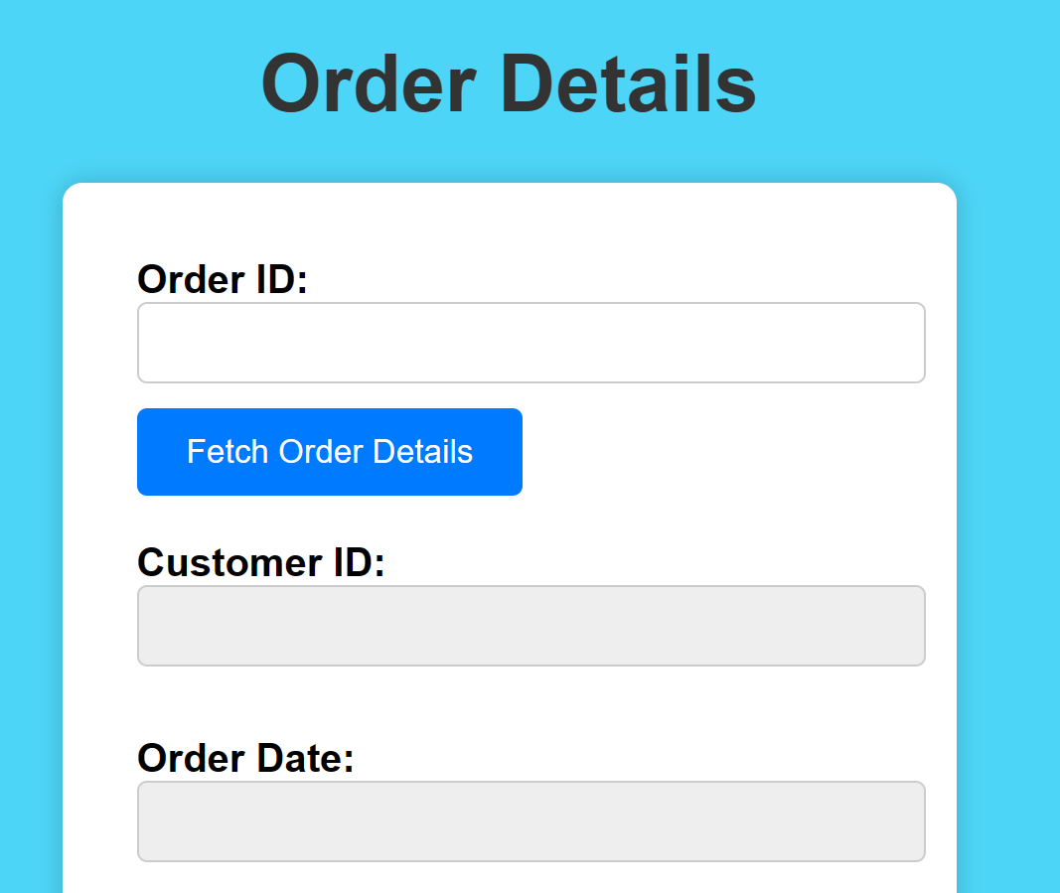
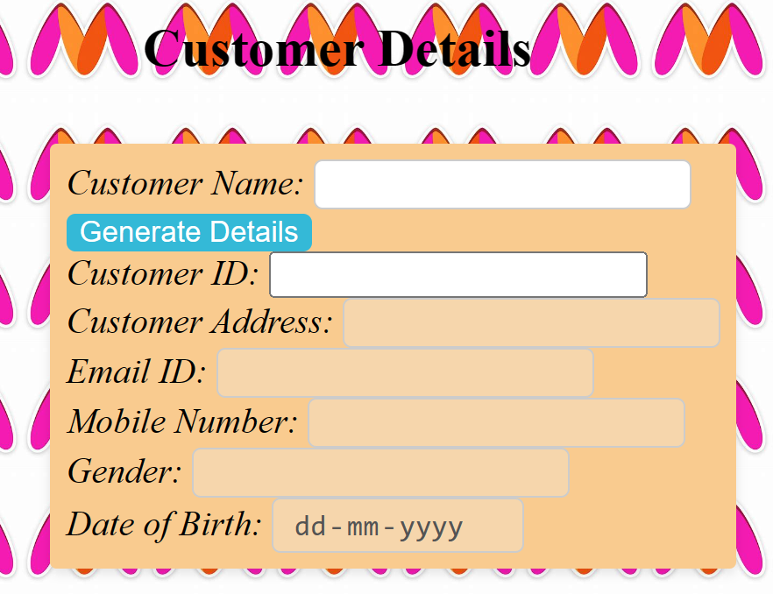
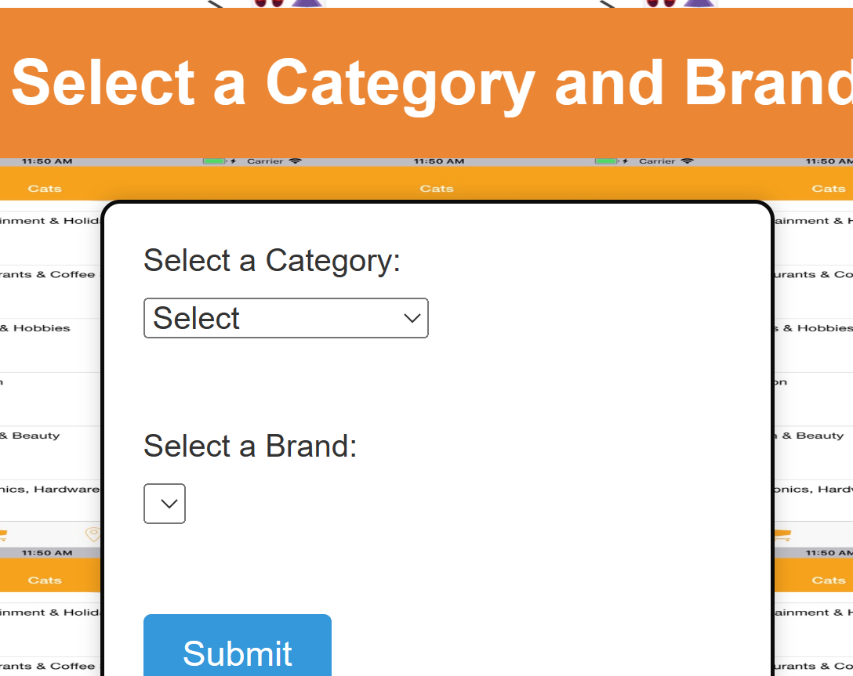
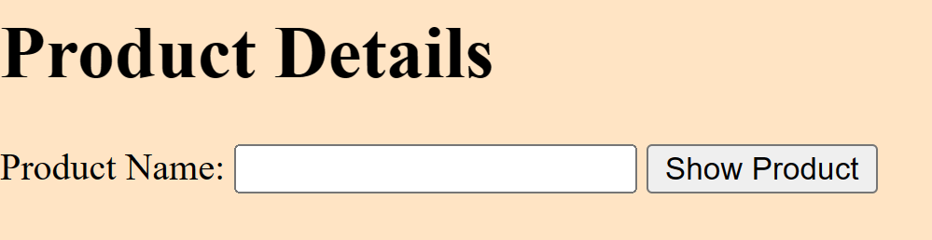
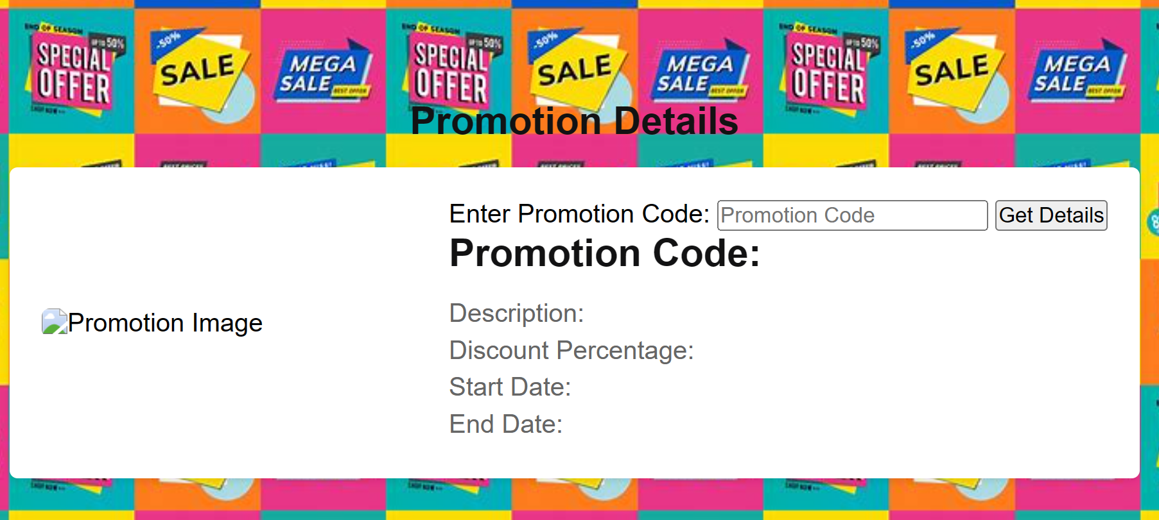
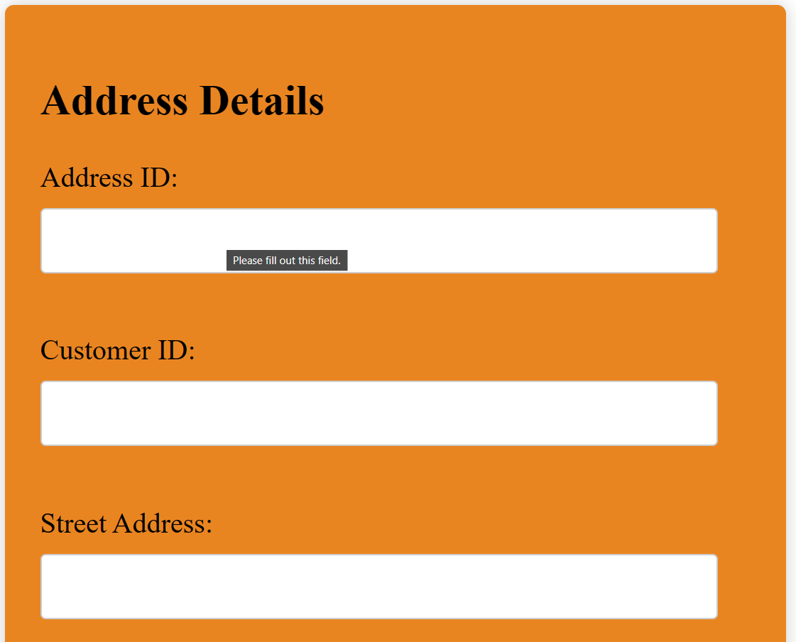
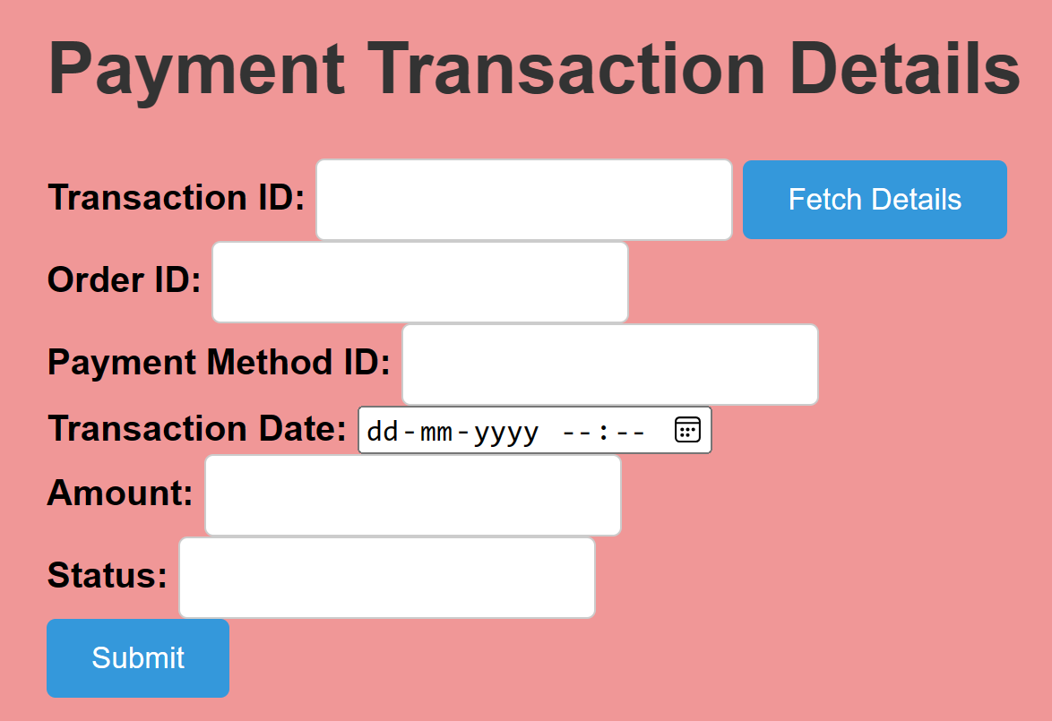
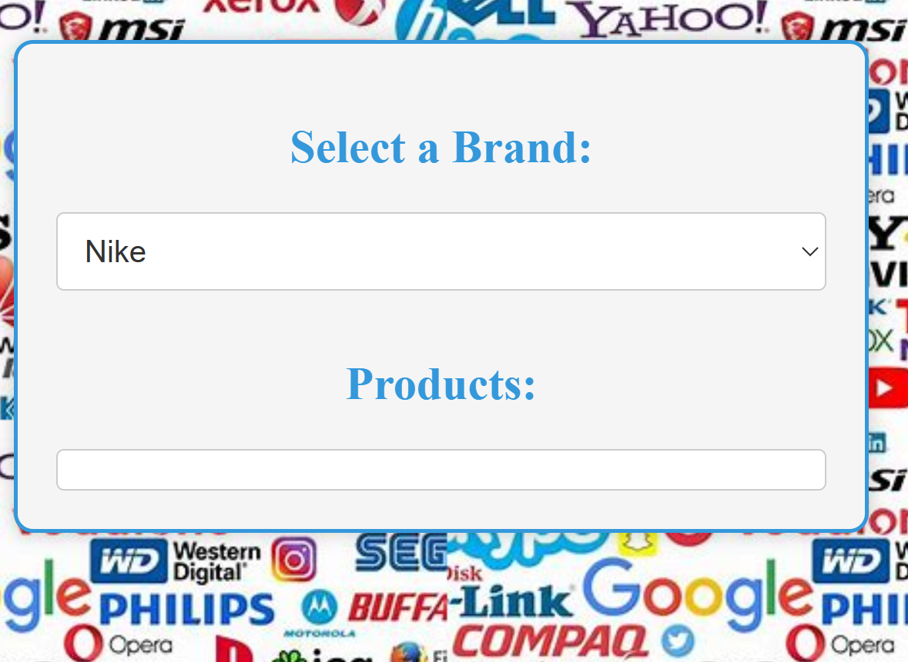
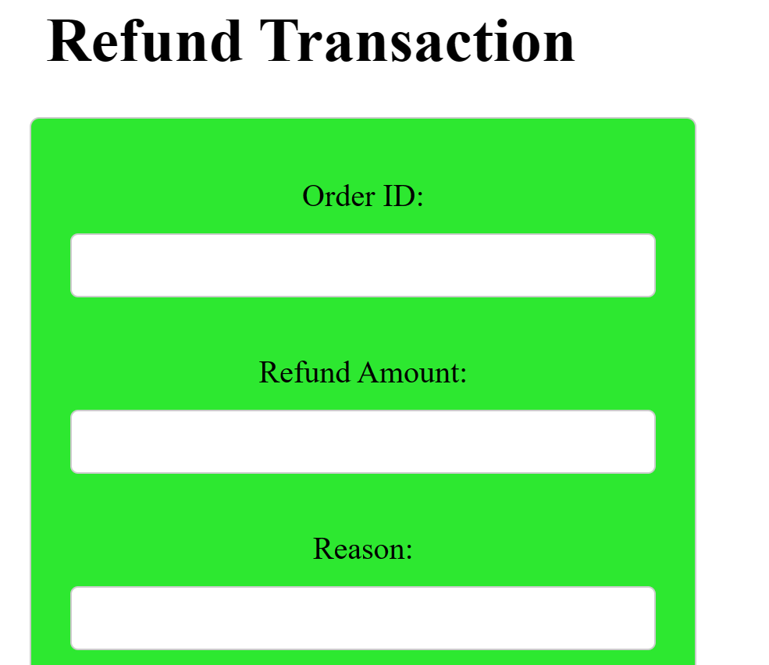
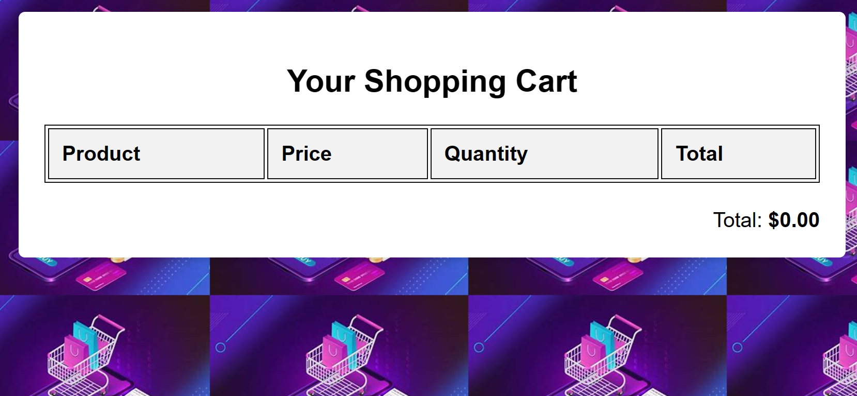
FORMS

Slide 22
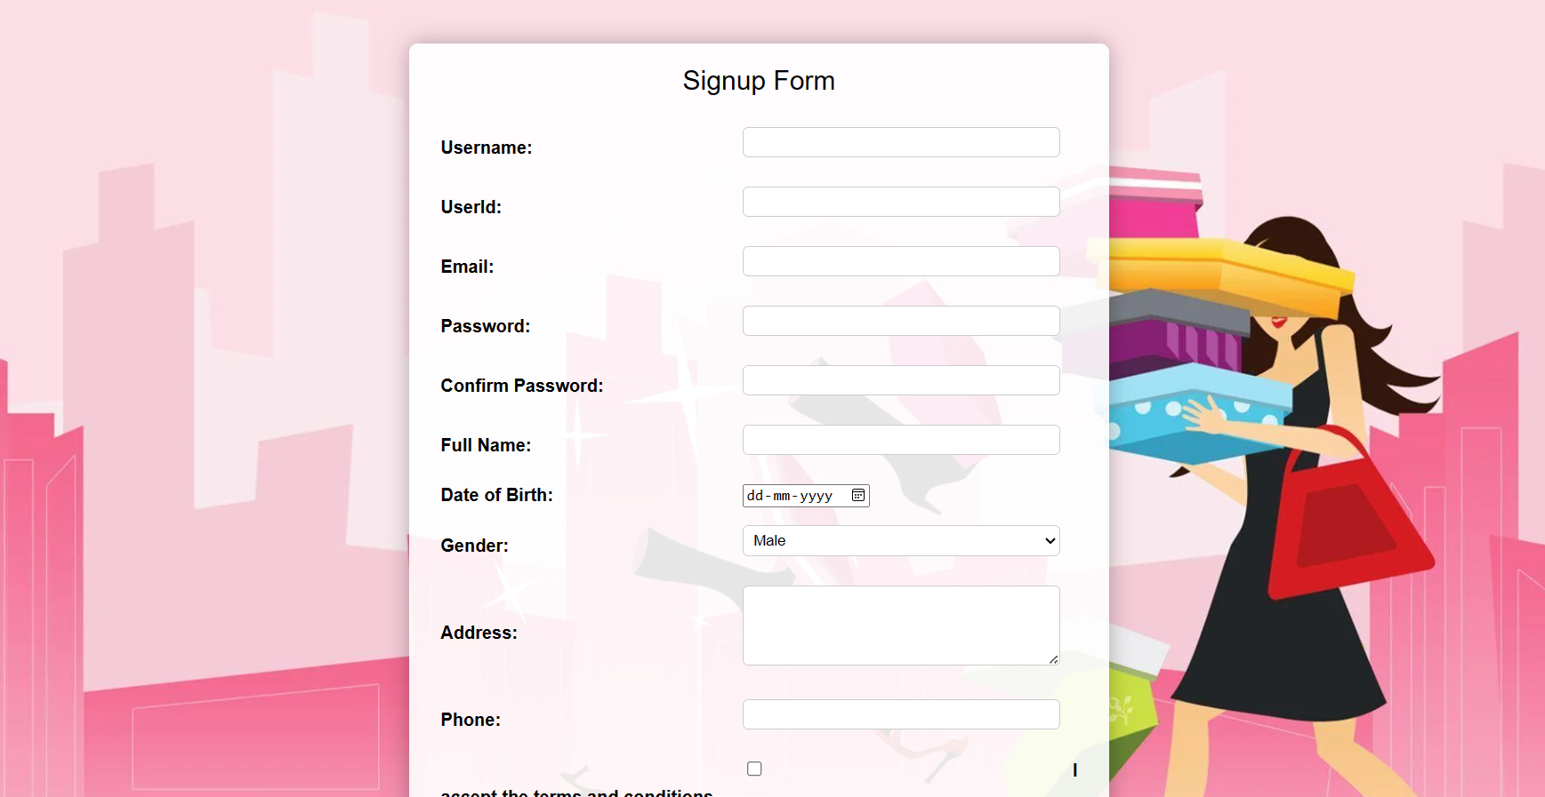
NO SQL
Flexible, scalable databases for diverse data; handles large volumes without fixed schemas. Examples: MongoDB, Cassandra, Redis. Ideal for web apps, real-time analytics, IoT, and large-scale systems.
Form Name​ | Category(Master​ /Transaction)​ | Table Name associated with the form​ | Form Name /css​ For ex: Emp_master.html​ Emp_master.css​ | File Name for reference in the shared drive​ | Type of operations​ (Insert/Update/Delete​ /Search/Display)​
Signup form | user form​ | user​ | Process.html​ Signup.css​ | process.html​ process.js​ | insert​

